Slide 1
The Glorious Quran
and its answer to
Islamic Eschatology
The Study of the Glorious Quran and how it responds to the signs of the End times.
By: Moneeb Minhas

Slide 2
Layla-tul Qadr
Mubarak?

Slide 3
Contents
PART 1 - The Quran speaks to us
PART 2 Some mathematical miracles of the Quran
PART 3 Some scientific miracles of the Quran
PART 4 - Ulum ul-Quran – Quranic Exegesis
PART 5 - Some signs of the End Times (Ilm ul Akhirun Zaman)
PART 6 - Quran and its answer to the Islamic Eschatology (end times) Ilm ul Akhairu-zaman.

Slide 4
PART 1:
The Quran speaks to us
القرآن يخاطبنا

Slide 5
Who are you? What is your name?
“Indeed this is the Quran…”
17:9

Slide 6
Where have you come from? Or Who sent you?
“Indeed it is a glorious Quran, (inscribed) in a tablet preserved”
85:21
“Behold, it is We (God) Ourselves who have bestowed from on high, (step by step), this reminder? and, behold, it is We who shall truly guard it [from all corruption]”
15:9

Slide 7
Who have you come for?
“Indeed We have sent down the Book to you (Oh Muhammad) with the truth for [the deliverance of] mankind”
39:41
“Certainly We have sent down to you (Oh Mankind!) a Book in which there is an admonition for you. Will you then not understand?”.
21:10

Slide 8
Which language do you speak?
“Indeed, We have sent it down as an Arabic Qur'an that you might understand.”
12:2

Slide 9
When did you come?
“We sent the Quran down in the month of Ramadan...”
2:185
“We have indeed revealed this in the Night of Power (Lailat al-Qadr).”
97:1

Slide 10
Why have you come?
“ ....... a guidance for mankind and clear evidence of guidance and discrimination (between wrong)”.
2:185
“…And We have sent down to you (Oh Muhammad) the Book (Quran) which explains all things…”
16:89

Slide 11
PART 2:
Some Miracles of the Quran…

Slide 12
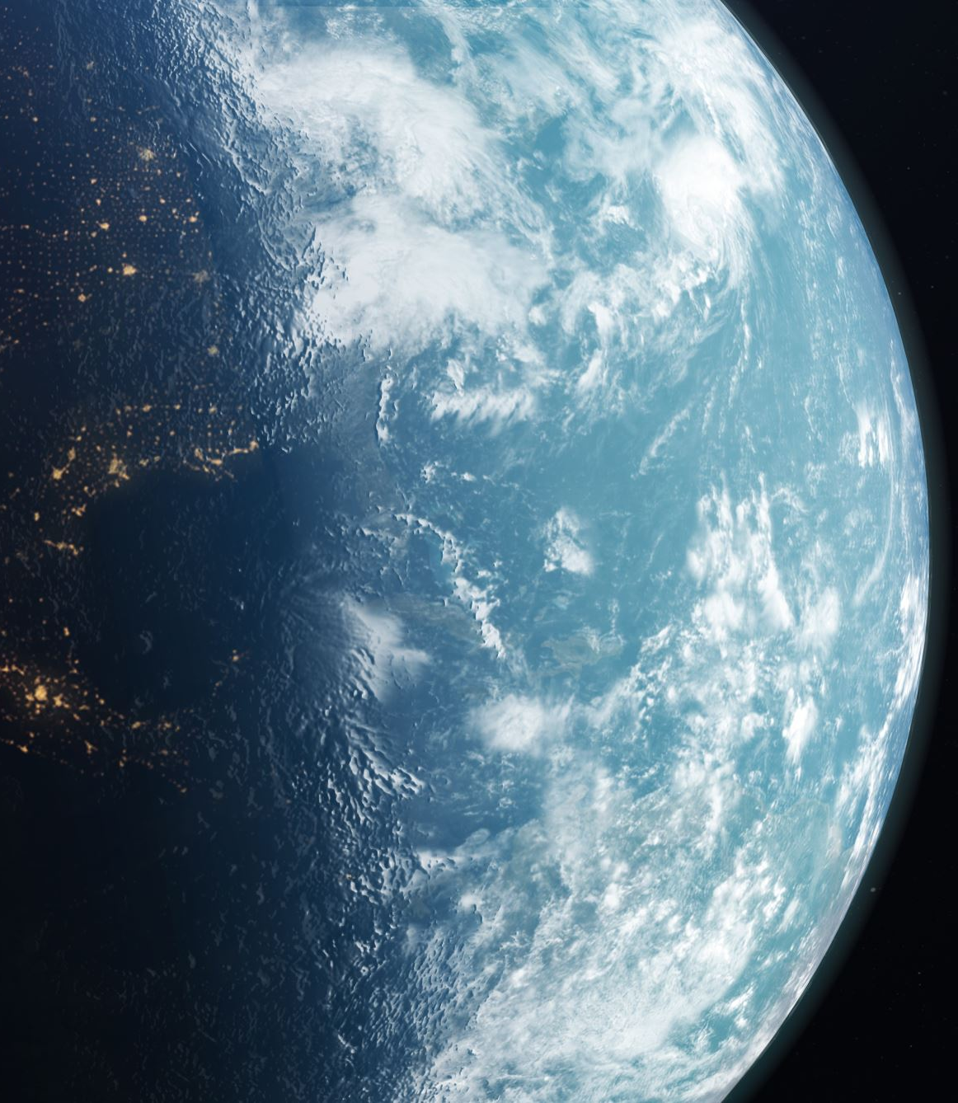
Some Scientific miracles of the Quran
How the universe came into existence - The big bang mentioned in Quran (21:30)
Water being the source of life (21:30)
Embryology – how the baby is formed in the womb (23:12-14)
The ozone layer or the sky as a protective barrier (21:32)
Iron brought down from outer space (57:25)

Slide 13
Some Scientific miracles of the Quran
Water brought down from outer space (16:65)
Formation of mountains (78:6-7)
Internal waves in the oceans (24:4)
Water cycle and cloud formations (39:21 / 15:21)
Recognising we all have unique fingerprints (75:3-4)

Slide 14
Some Mathematical miracles of the Quran
Al Yawm (Day)
X365
Ayyaam, Yawmayn (Days)
x30 times
Shahar (Month)
X12
Salawaat (Prayer)
x5

Slide 15
Some Mathematical miracles of the Quran
Opposites and equals
Al-Dunya (This world) 115
Al-Akhira (The hereafter) 115
Al-Mala'ikah (Angles) 88
Al-Shayateen (Satan) 88
Al-Hayat (Life) 145
Al-Maout (Death) 145
As Saliha – Good Deed 167
As-Sayiha – (Bad deed) 167
Al-Rajul (Man) 23
Al-Mar'ha (Women) 23
(humans have 23 pairs of chromosomes)

Slide 16
PART 3:
Ulum ul-Quran
(Tafseer and Taweel, Ibara and Ishara, Zhahir and Batin)

Slide 17
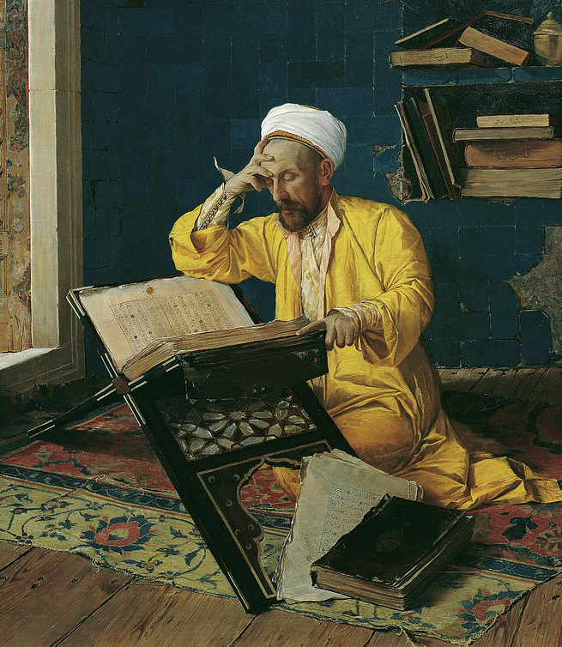
Tafseer
“fassara” - ‘to explain, to expound, to elucidate, to interpret.’
Uses exoteric meanings of verses to help understand them.
Also known as Exegesis or Commentary

Slide 18
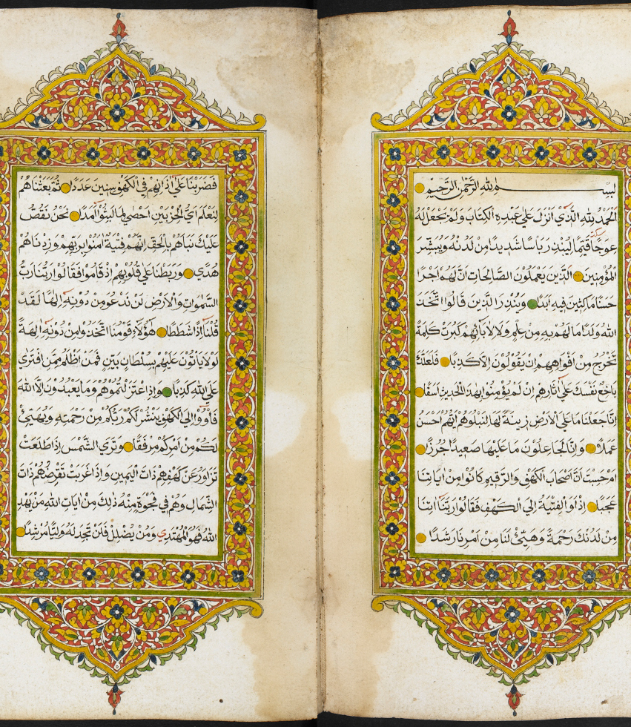
Ta’weel
“awl’ - ‘to return, to revert’
It uses Exoteric (Zhahir) and Esoteric (Batin) meanings of the verse to help understand it and draw conclusions.
Requires much research, dedication, knowledge and study by the scholar.

Slide 19
Exoteric (Zahir)
Esoteric (Batin)
The outer dimensions
The literal meaning
The Zahiri meaning
Uses Ibara
Take direct meaning
Requires outer knowledge eg: language, context (asbab-ul-nazul), history
Used mainly for Tafseer
The inner dimensions
The metaphoric meaning
Parables and interpretations
Use ibara and Ishara
Takes the implied or hidden meaning
Requires in-depth study
Requires inner knowledge eg: spiritual,
Used mainly for Ta’weel

Slide 20
4 types of

Slide 21
PART 4:
Some Signs of the End times (Islamic Eschatology)

Slide 22
1. Splitting of the Moon.
2. Birth and Death of the Prophet Muhammad, may Allah bless him and grant him peace.
3. A form of death which will kill thousands of Muslims. (Understood to refer to the plague of Amwas during the caliphate of ‘Umar ibn al-Khattab.)
4. A major fighting in Madinah (understood to refer to the battle of al-Harrah during the caliphate of Yazid, 63 AH).
5. The Muslim conquest of Jerusalem.
6. The Muslim conquest of Constantinople.
7. Two large groups of Muslims will fight in war.
8. A war between the Muslims and a reddish people with small eyes, wearing sandals made of hair (understood to refer to the Mongol Tatar invasion of the Islamic lands.)
9. A peace agreement between the Muslims and non-Muslims from the yellow race (Chinese, Mongols, etc.)
10. Thirty impostors (dajjal) will appear, each thinking he is a prophet.
Present?
11. Naked, destitute, barefoot shepherds will compete in building tall buildings.
12. The slave-woman will give birth to her master or mistress.
13. A trial (fitnah) which will enter every Arab household.
14. Knowledge will be taken away (by the death of people of knowledge), and ignorance will prevail.
15. Wine (intoxicants, alcohol) will be drunk in great quantities.
16. Illegal sexual intercourse will become widespread.
17. Earthquakes will increase.
18. Time will pass more quickly.
19. Tribulations (fitan) will prevail.
20. Bloodshed will increase.
21. A man will pass by the grave of another and wish he was in the latter’s place.
22. Trustworthiness will be lost, i.e. when authority is given to those who do not deserve it.
23. People will gather for prayer, but will be unable to find an imam to lead them.
Future
24. The number of men will decrease, whilst the number of women will increase, until for every man there are 50 women.
25. The Euphrates will reveal a treasure of gold, and many will die fighting over it, each one hoping to be the one who gains the treasure.
26. The Romans (Europeans) will come to a place called A’maq or Wabiq, and an army of the best people will go forth from Madinah to face them.
27. The Muslim conquest of Rome.
28. The Mahdi (guided one) will appear, and be the Imam of the Muslims.
29. Jesus Christ will descend in Damascus, and pray behind the Mahdi.
30. Jesus will break the cross and kill the swine, i.e. destroy the false christianity.
50 Signs of the End Times

Slide 23
31. The Antichrist (al-masih al-dajjal, the false christ) will appear, with all his tools of deception, and be an immense trial. He will be followed by 70,000 Jews from Isfahan (present-day Iran).
32. The appearance of Ya’juj and Ma’juj (Gog and Magog), and the associated tribulations.
33. The emergence of the Beast from the Earth, carrying the Staff of Moses and the Seal of Solomon, who will speak to the people, telling them they did not believe with certainty in the Divine Signs.
34. A major war between the Muslims (including Jews and Christians who truly believe in Jesus after his return) led by the Imam Mahdi, and the Jews plus other non-Muslims led by the Antichrist.
35. Jesus will kill the Antichrist at the gate of Ludd (Lod in present-day Israel, site of an airport and a major Israeli military base).
36. A time of great peace and serenity during and after the remaining lifetime of Jesus.
37. Wealth will come so abundant that it will become difficult to find someone to accept charity.
38. Arabia will become a land of gardens and rivers.
39. Society will then decay.
40. The buttocks of the women of the tribe of Daws will again sway in circumambulation (tawaf) around the idol Dhul-Khulsah.
41. A great fire in the Hijaz, seen by the inhabitants of Busra.
42. Three major armies will sink into the earth: one in the east, one in the west, one in Arabia.
43. An Abyssinian leader with thin shins will destroy the Ka’bah.
44. The huge cloud of smoke.
45. The sun will rise from the west (its place of setting).
46. A gentle wind which will take the souls of the believers.
47. There is no-one left on the earth saying, "Allah, Allah" or "There is no god except Allah."
48. Eventually the Day of Judgment is established upon the worst of the people, who copulate like donkeys in public.
49. The blowing in the Trumpet by the Angel Israfil, upon which everyone will faint except as Allah wills.
50. The second blowing in the Trumpet, upon which everyone will be resurrected.
50 Signs of the End Times

Slide 24
PART 5:
Quran and its answer to the End Times.

Slide 25
End Time is near
“The hour of judgment is near, and the moon is split,”
(54:1)

Slide 26
“Verily the hour is coming. My (God’s) design is to keep it hidden, so that every soul be rewarded by the measure of its endeavor,”
(20:15)

Slide 27
“Verily the knowledge of the hour is with God alone”
(31:34)

Slide 28
“Men ask you about the hour. Say: knowledge of it is with God (Alone). What will make you understand that the hour maybe (very) near,”
(33:63)

Slide 29
Some Explicit signs of the last day mentioned in Quran

Slide 30
Beast of the earth
“When the word [of judgement] falls upon them, We shall bring out for them a Beast from the earth”
(27:82)

Slide 31
Yajuj wa Majuj (Gog and Magog) and the barrier
“But there is a ban on (the people of the) City which We have destroyed: that they (the residents) shall not return - Until Gog and Magog are let loose (their barrier) and they swiftly spread out in every direction.”
(21:95-96)

Slide 32
Yajuj wa Majuj (Gog and Magog) and the barrier
“He said, ‘This is a mercy from my Lord. But when the promise of my Lord is fulfilled, He will level it; and my Lord’s promise is true. And on that day (ie: the day Yajuj Majuj are released) We shall let them surge like waves on one another, and the Trumpet will be blown, and We shall gather them all,”
(18:98-99)

Slide 33
Jesus’ (as)
“Indeed he (Jesus) is a sign of the Hour; so do not doubt it and follow me”
(43:61)

Slide 34
What about the Dajjal (Anti-Christ)?
In Sahih Al Bukhari alone the word Dajjal appears 83 times within 53 Ahadith.
No doubt he is an important figure in relation to the end times
The Prophet (Saw) even said: “There is no prophet that was sent to this world that did not warn his people about Dajjal” (Bukhari)

Slide 35
Dajjal
Once Allah's Messenger (ﷺ) stood amongst the people, glorified and praised Allah as He deserved and then mentioned the Dajjal saying, "l warn you against him (i.e. the Dajjal) and there was no prophet but warned his nation against him. No doubt, Noah warned his nation against him but I tell you about him something of which no prophet told his nation before me. You should know that he is one-eyed, and Allah is not one-eyed.“
Sahih al-Bukhari 3337

Slide 36
Hadith on Dajjal
The Messenger of Allah (ﷺ) mentioned Dajjal, one morning, as something despised but also alarming, until we thought that he was in the stand of date-palm trees. When we came to the Messenger of Allah (ﷺ) in the evening, he saw that (fear) in us, and said: 'What is the matter with you?' We said: 'O Messenger of Allah, you mentioned Dajjal this morning, and you spoke of him as something despised but also alarming, until we thought that he was in the stand of date-palm trees.' He said: 'There are things that I fear more for you than the Dajjal. If he appears while I am among you, I will contend with him on your behalf, and if he appears when I am not among you, then each man must fend for himself, and Allah will take care of every Muslim on my behalf. He (Dajjal) will be a young man with curly hair and a protuberant eye; I liken him to 'Abdul-'Uzza bin Qatan. Whoever among you sees him, let him recite the first Verses of Surat Al-Kahf over him. He will emerge from Khallah, between Sham and Iraq, and will wreak havoc right and left. O slaves of Allah, remain steadfast.' We said: 'O Messenger of Allah, how long will he stay on earth?' He said: 'Forty days, one day like a year, one day like a month, one day like a week, and the rest of his days like your days.' We said: 'O Messenger of Allah, on that day which is like a year, will the prayers of one day suffice us?' He said: 'Make an estimate of time (and then observe prayer).' We said: 'How fast will he move through the earth?' He said: 'Like a rain cloud driving by the wind.' He said: 'He will come to some people and call them, and they will respond and believe in him. Then he will command the sky to rain and it will rain, and he will command the earth to produce vegetation and it will do so, and their flocks will come back in the evening with their humps taller, their udders fuller and their flanks fatter than they have ever been. Then he will come to some (other) people and call them, and they will reject him, so he will turn away from them and they will suffer drought and be left with nothing. Then he will pass through the wasteland and will say: "Bring forth your treasures," then go away, and its treasures will follow him like a swarm of bees. Then he will call a man brimming with youth and will strike him with a sword and cut him in two. He will put the two pieces as far apart as the distance between an archer and his target. Then he will call him and he will come with his face shining, laughing. While they are like that, Allah will send 'Eisa bin Maryam, who will come down at the white minaret in the east of Damascus, wearing two Mahrud[garment dyed with Wars and then Saffron], resting his hands on the wings of two angels. When he lowers his head, beads of perspiration will fall from it. Every disbeliever who smells the fragrance of his breath will die, and his breath will reach as far as his eye can see. Then he will set out and catch up with him (the Dajjal) at the gate of Ludd, and will kill him. Then the Prophet of Allah 'Eisa will come to some people whom Allah has protected, and he will wipe their faces and tell them of their status in Paradise. While they are like that, Allah will reveal to him: "O 'Eisa, I have brought forth some of My slaves whom no one will be able to kill, so take My slaves to Tur in safety." Then Gog and Magog will emerge and they will, as Allah describes, "swoop down from every mound."[21:96] The first of them will pass by lake Tiberias and drink from it, then the last of them will pass by it and will say: "There was water here once." The Prophet of Allah, 'Eisa and his companions will be besieged there until the head of an ox would be dearer to any one of them than one hundred Dinar are to any one of you today. Then, the Prophet of Allah, 'Eisa and his companions will supplicate Allah. Then Allah will send a worm in their necks and the next morning they will all die as one. The Prophet of Allah 'Eisa and his companions will come down and they will not find even the space of a hand span that is free of their stink, stench and blood. They will pray to Allah, and He will send birds with necks like the necks of Bactrian camels, which will pick them up and throw them wherever Allah wills. Then Allah will send rain which will not leave any house of clay or hair, and it will wash the earth until it leaves it like a mirror (or a smooth rock). Then it will be said to the earth: "Bring forth your fruits and bring back your blessing." On that day a group of people will eat from a (single) pomegranate and it will suffice them, and they will seek shelter beneath its skin. Allah will bless a milch- camel so that it will be sufficient for a large number of people, and a milch-cow will be sufficient for a whole tribe and a milch-ewe will be sufficient for a whole clan. While they are like that, Allah will send a pleasant wind which will seize them beneath their armpits and will take the soul of every Muslim, leaving the rest of the people fornicating like donkeys, and upon them will come the Hour.’”
REF: Sunan Ibn Majah 4075 (Sunan Ibn Majah 4075 - Tribulations - كتاب الفتن - Sunnah.com - Sayings and Teachings of Prophet Muhammad (صلى الله عليه و سلم)

Slide 37
Dajjal – Summary
Full title is Masih-Ad-Dajjal (Anti Christ)
Described as being one-eyed
Described as “He (Dajjal) will be a young man with curly hair and a blind eye.”
Some narrations say his right eye will be defective and others say left.
The words “Kaafir (Disbeliever)” is written on his head between his eyes
Won’t have progeny
Followed by all people from all nations, but predominantly from the Jews
Can travel faster than the clouds
Will visit each town and city – his message will reach every home
He can bring people back to life
He can control the rain and will have miracles similar to Prophets.
He will be a master of deception
Dajjal will come with fire and water. What would seem to be water, will be fire, and fire will be cold water.
he will have a paradise and a hell with him, but his paradise will be his hell and his hell will be his paradise.
Forbidden from entering Makkah or Madinah

Slide 38
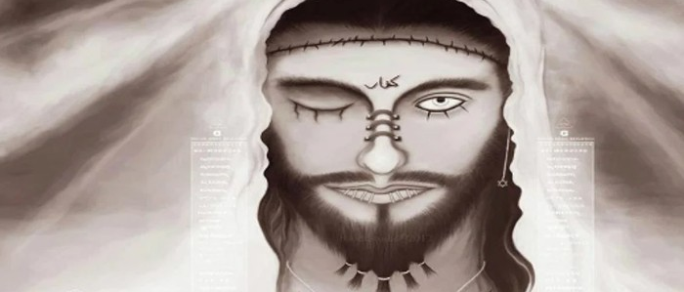
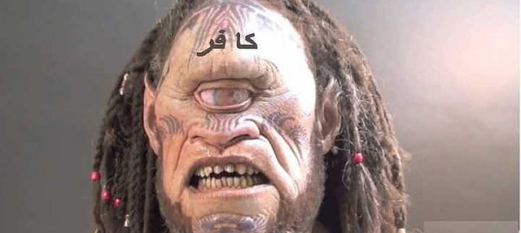
Dajjal (Anti-Christ)

Slide 39
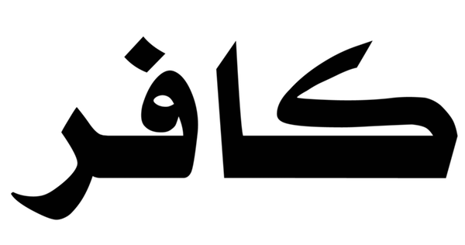
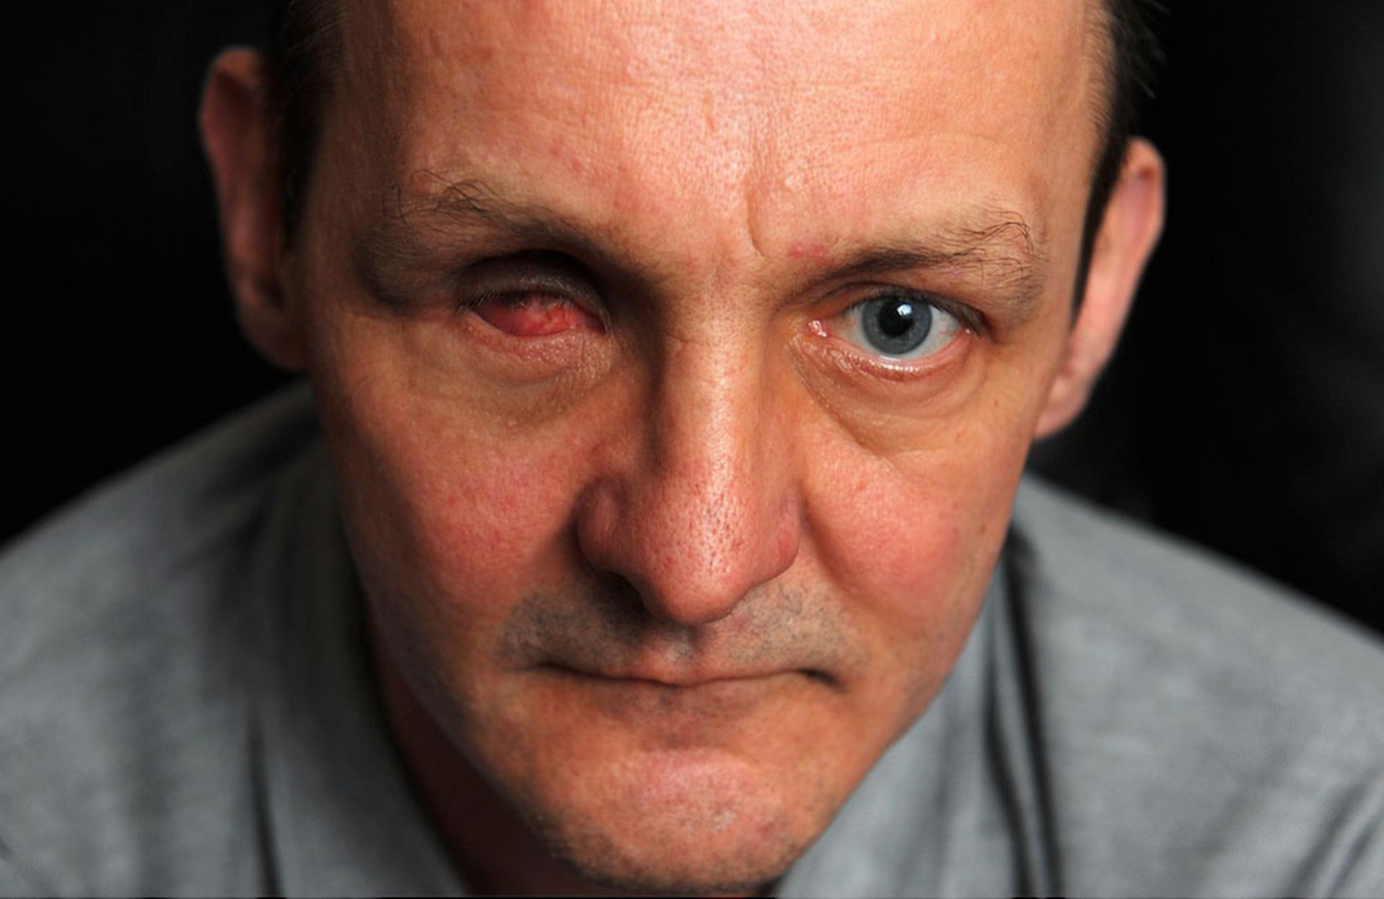

Slide 40
Hadith on protection from the Dajjal
Abu Darda reported that Allah’s Messenger said, "If anyone memorizes the first ten verses of Surah al-Kahf, he would be protected from Dajjal. ” (Sahih Muslim)
"He who among you will survive to see him (Dajjal) should recite over him the opening verses of Surah al-Kahf.” - (Sahih Muslim)
“He who recites three verses at the beginning of al-Kahf would be protected from the trial of the Dajjal.” (Tirmidhi)
Abu Sa ’id al-Khudri reports that the Prophet said: "Whoever recites Surah al-Kahf on Jum'ah (i.e., 'Friday’ of the pagan world) would have illumination from the light (of the Surah) from one Jum 'ah to the next. ” (Nasa’i, Baihaql, Hakim)

Slide 41
Story of Musa (as) and Khidr (as)

